Slide 1
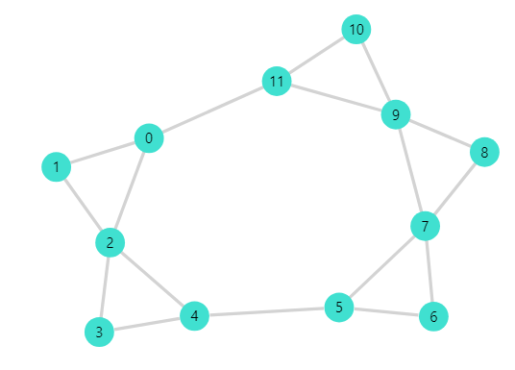
Chord Progression Network Analysis of Ray Charles Jazz Songs
(Team 9): Gehan Velivitiya, Juanita Ramirez Villanueva
This project seeks to understand music from a structural perspective and represent its components in graphs.
Music is composed of 12 notes, the "minimal" unit (in western music).
Sequences of notes form scales, a melodic structure.
Two notes played simultaneously make consonant or dissonant sounds, that creates a type of relationship between notes.
Three or more notes played simultaneously make chords which form the structure of a song.

Slide 2
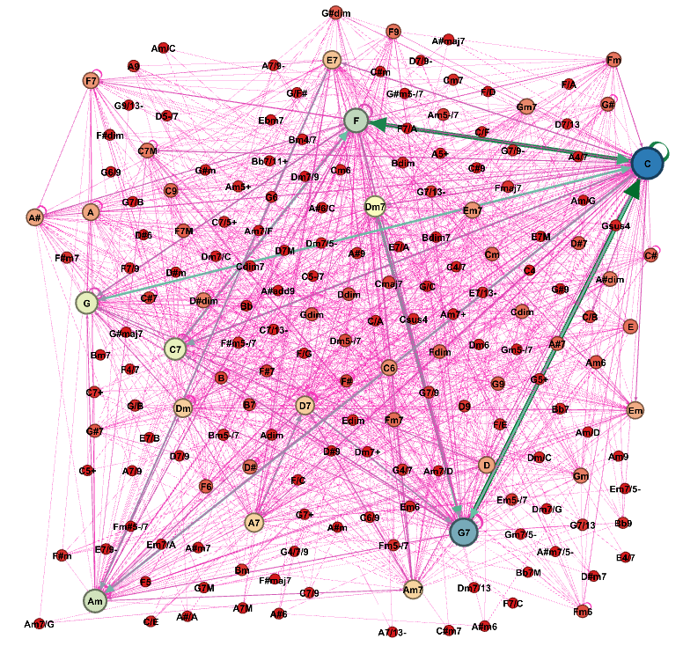
Exploratory Data Analysis
We created our own dataset by extracting chords from 88 Ray Charles song lyrics downloaded from https://www.e-chords.com/ray-charles
The constructed dataset has two .csv files, which is node.csv with columns id, label and edge.csv with columns source, target and type.
The nodes represent chords and edges represent the transition from one chord to the next. The network has 183 nodes and 2525 edges.
This is a directed network. Nodes have in degree and out degree.
Weight of edges determined based on the no. of songs that particular chord progression appeared.

Slide 3
Research Questions
We expect to find similarities between the general Jazz Chord Progression Network produced by the researchers of paper “Network Analysis of Chord Progression in Rock and Jazz Music” and the Ray Charles Chord Progression network, a wide variety of chords and a low clustering coefficient and density, that would translate into complex chord progressions.
Does Ray Charles has a unique structure in his songs?
Does his music structure varies with time or by genre?
Our objective is to construct a single graph with all chord progressions across the 88 songs. By doing so to identify whether the network is scale free network? if so what information it gives about the robustness?
In Jazz are the common chords(i.e. A,B,C,D,E,F,G) used or does it use any additional chords. By identifying this we can conclude the unique patterns that makes Jazz deviate from other genres.

